Slide 1

ARTIFICIAL INTELLIGENCE
&
MACHINE LEARNING

Slide 2

OVERVIEW : AI & ML
Artificial Intelligence
A field of computer science that creates systems able to perform tasks that normally require human intelligence, such as learning, reasoning, recognising patterns, understanding language, and making decisions.
It uses data and algorithms to let machines improve their performance over time without needing explicit step-by-step instructions for every situation.
Machine Learning
A subfield of AI that trains computer systems to learn patterns from data so they can make predictions or decisions without explicit rule-based programming.
It uses algorithms and statistical models that automatically improve performance as more data and experience become available.

Slide 3
MACHINE LEARNING CONCEPTS
Supervised Learning
Definition: A Model learns from labelled data (input-output pairs) to predict outcomes.
Examples: Classification (spam detection, disease diagnosis), Regression (price prediction, temperature forecasting).
Use case: When you have historically labelled data and need to predict known outcomes.
Unsupervised Learning
Definition: A Model discovers hidden patterns in unlabeled data without predefined answers.
Examples: Clustering (customer segmentation, document grouping), Dimensionality reduction (feature extraction).
Use case: When exploring data structure or finding natural groupings without labelled examples.

Slide 4
MACHINE LEARNING CONCEPTS
Semi-Supervised Learning
Definition: Combines small amounts of labeled data with large amounts of unlabeled data for training.
Examples: Text classification with few labeled samples, image recognition with partially labeled datasets.
Use case: hen labeling data is expensive but you have abundant unlabeled data available.
Reinforcement Learning
Definition: Model learns by interacting with an environment and receiving rewards/penalties for actions.
Examples: Game playing (chess, Go), robotics control, autonomous vehicles, recommendation systems.
Use case: When the goal is to optimize decision-making through trial-and-error and feedback loops.

Slide 5
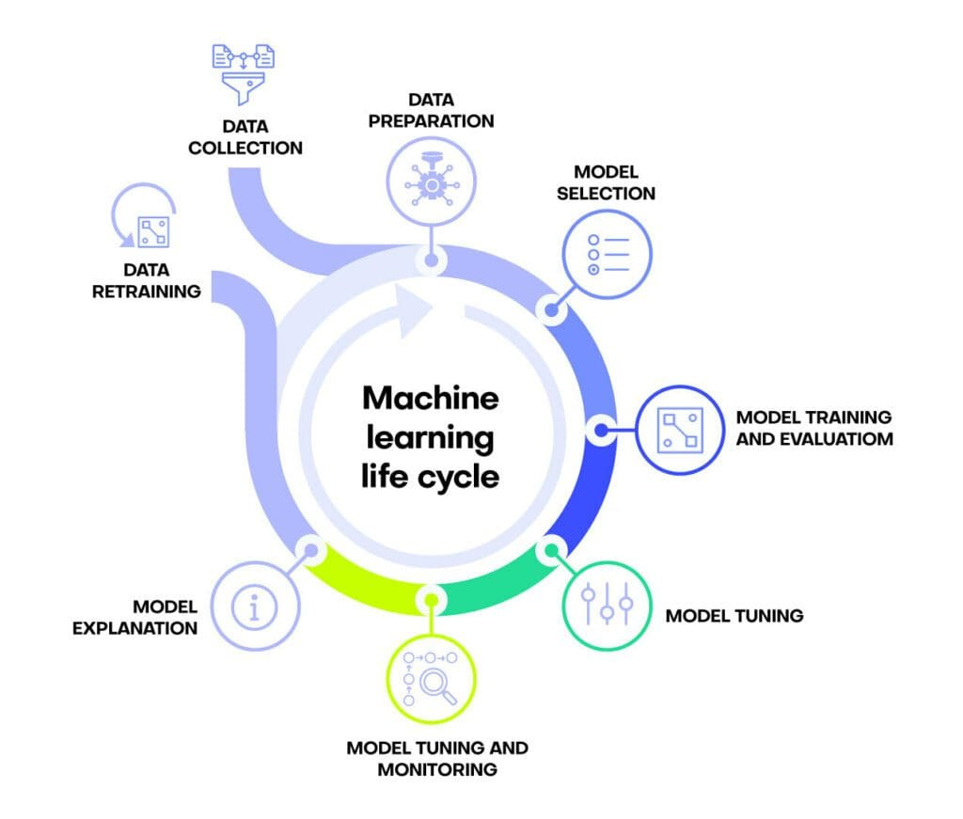

Slide 6
UNDERSTANDING THE
BUSINESS PROBLEM
Identify the Real-World Problem: Understand what challenge or opportunity exists in the business - or domain - what gap needs to be filled or what inefficiency needs to be solved.
Clarify the Use Case Scope: Define the specific scenario where the model will be applied - who will use it, when, where, and under what conditions (e.g., real-time prediction vs. batch processing).
Establish Domain Knowledge & Context: Consult with domain experts and stakeholders to understand the underlying patterns, rules, and nuances of the problem space before assumptions are made about data needs.
Validate Feasibility with Available Resources: Assess whether the problem can realistically be solved with AI/ML given existing data sources, computational resources, and time constraints—before committing to a full data collection effort.

Slide 7
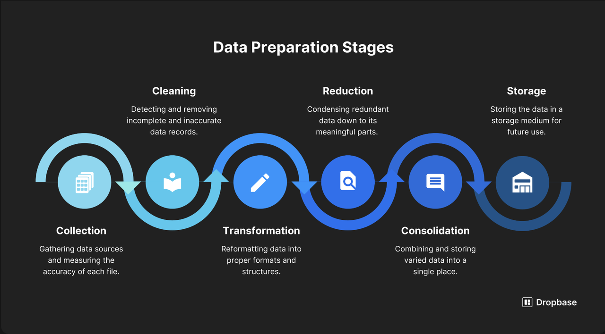
DATA COLLECTION & PREPARATION
Stage 2 is about turning raw data into clean, ML‑ready data.
1.Gather relevant data
Pull only data that is clearly linked to the problem from sources like databases, logs, sensors, CRM tools, public datasets, or APIs.
Avoid noisy or irrelevant fields that do not help prediction.
2.Validate data quality
Check completeness, accuracy, consistency (formats/units), and recency so the data reflects current reality.
Fix or remove duplicate, impossible, or clearly wrong records.
3.Handle missing values and outliers-
Drop, impute, or flag missing values based on feature importance and missing rate, and treat outliers by capping, transforming, or removing them when they are errors rather than valid rare cases.
4.Ensure sufficient and representative data
Ensure each class or segment has enough samples and handle imbalance using oversampling, undersampling, or class‑weighted models.
5.Typical preparation steps
Standardize formats, scale numeric features, encode categorical variables, remove leakage features, and then split data into train, validation, and test sets.

Slide 8
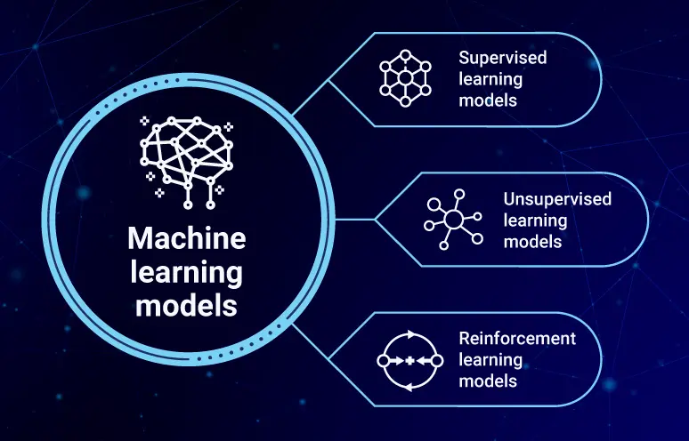
MODEL SELECTION
The process of choosing, from a set of candidate models, the one that best fits the data and task while still generalising well to unseen examples.
Common criteria for model selection include:
Predictive performance on validation data (e.g., accuracy, F1-score, MSE, AUC).
Generalisation ability (low overfitting, good bias–variance trade-off).
Model complexity (simpler models preferred when performance is similar).
Interpretability (how easily humans can understand the model).
Computational cost (training/inference time and memory).
Data fit and assumptions (how well the model’s assumptions match the dataset).

Slide 9
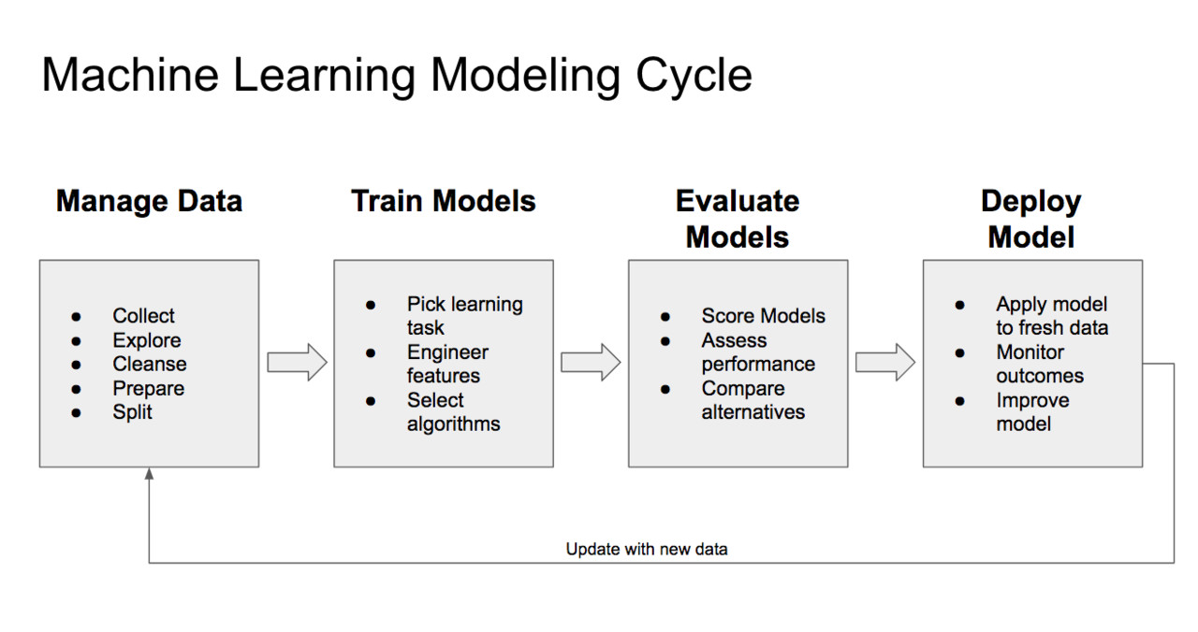
MODEL TRAINING & EVALUATION
Model Training
Data Preparation & Hyperparameter Tuning: Split data into train/test sets and adjust model parameters to optimize performance without overfitting.
Iterative Training: Train the model multiple times, refining features.
Model Evaluation
Performance Metrics: Measure model accuracy using appropriate metrics (Accuracy, Precision, Recall, F1-Score for classification).
Business Alignment & Error Analysis: Ensure model meets business objectives and analyze failure patterns.

Slide 10
AI PROJECT IMPLEMENTATION PROCESS
Stage 1: Choosing a Model
Select the right LLM based on your needs:
Examples: Llama 2/3 (open-source, customizable), GPT-4 (powerful, API-based), Mistral (lightweight, efficient), Claude (strong reasoning)
Criteria: Consider cost, latency, accuracy, size constraints, and whether you need local vs. cloud deployment
Integration: Access via Hugging Face, OpenAI API, AWS Bedrock, or local deployment
Stage 2: Retrieval-Augmented Generation (RAG) - Fetching Context
How it works:
User asks a question → System searches your knowledge base (documents, FAQs, internal data) for relevant context
Retrieved context is combined with the question and sent to the LLM
LLM generates a response grounded in your specific data, not just general knowledge

Slide 11
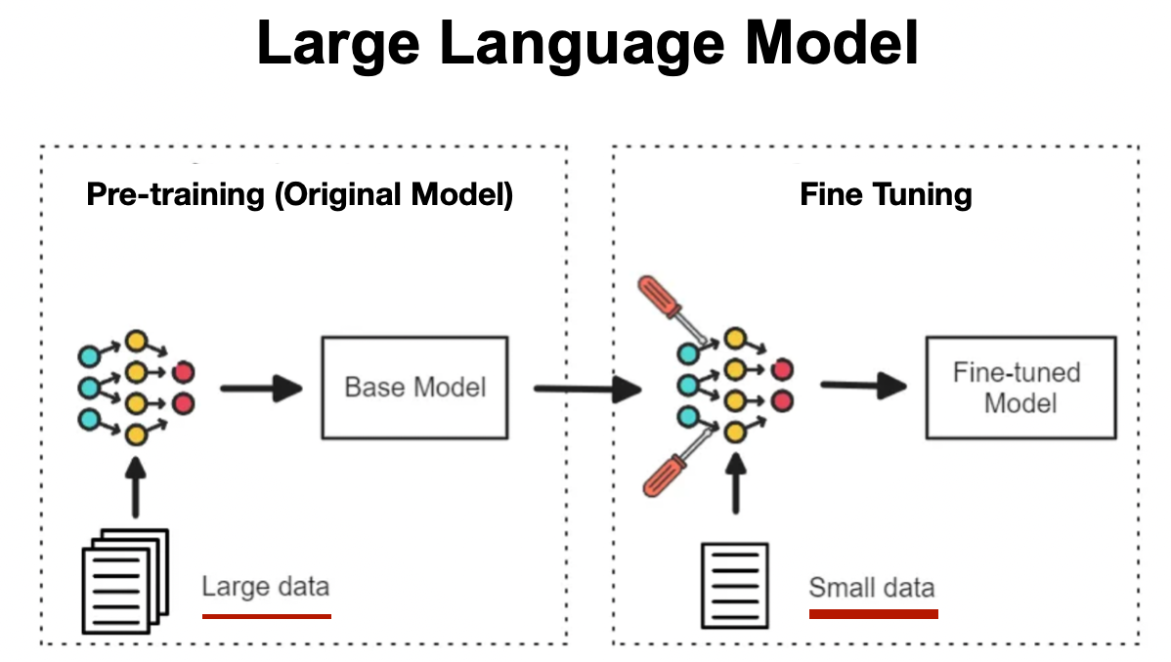
AI PROJECT IMPLEMENTATION PROCESS
Stage 3: Fine-tuning (Optional - When RAG isn't Enough)
When to fine-tune:
Model needs to learn your domain language, style, or specific patterns
RAG alone doesn't capture nuanced behavior you want
Process:
Prepare training data: Input-output pairs from your domain (e.g., customer queries + ideal responses)
Use parameter-efficient methods like LoRA to avoid high computational costs

Slide 12
THANK YOU!

